Slide 1
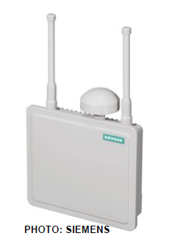
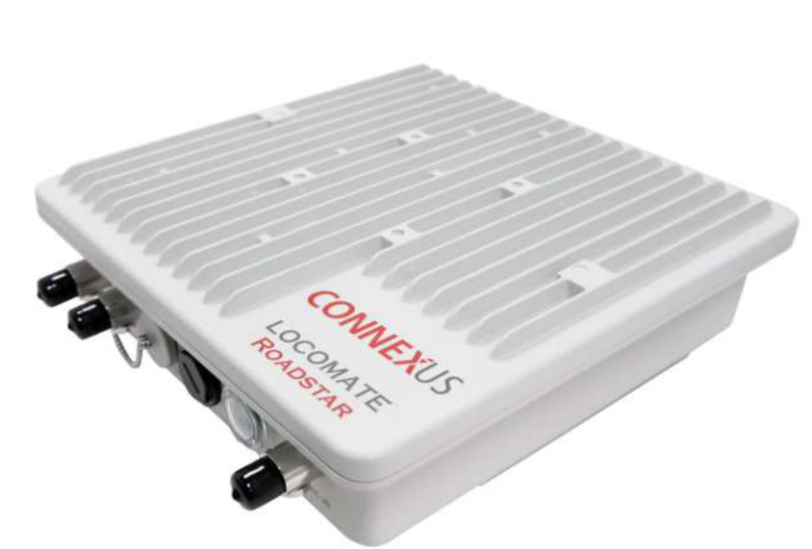
Connected Vehicle (CV) Technology Procurement
State of the Practice Analysis (2018)
Project Findings
and Key Products
Greg Hatcher, Noblis
November 13, 2019
WYDOT 2018
Notes:
This project addresses the question of how state DOTs and local agencies are purchasing connected vehicle equipment and systems today and what trends are emerging. The research was sponsored by the ITS JPO in cooperation with the Federal Highway Administration’s (FHWA’s) Office of Operations (task manager/lead John Corbin) and was conducted by the Noblis ITS on-site team last year (from Oct 2017-Sept 2018).
We would like to thank all the participants of the study for assisting us with data gathering and providing valuable insights into procurement approaches for connected vehicle technologies!

Slide 2
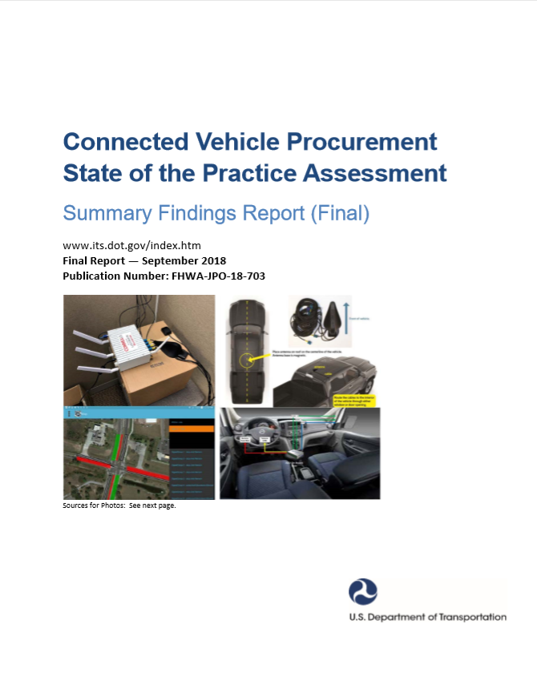
Connected Vehicle Procurement SOP Objectives
Connected Vehicle Procurement State of the Practice Assessment (Key Product)
https://rosap.ntl.bts.gov/view/dot/37173
Research and assess current state-of-the-practice for CV Procurement
  How do transportation agencies purchase (or plan to purchase) ITS CV equipment, systems, and services?
  “Case study” agencies to provide different real-world examples
Document challenges, lessons learned, and recommendations from early CV deployers
Identify potential actions for US DOT to facilitate successful connected vehicle procurements
Notes:
This slide covers the Major Objectives of the study. The intent was to determine how agencies are procuring or purchasing CV equipment, systems, and services…. Addressing questions such as “What methods are agencies using?” “How do agencies use consultants in the process”, and “What types of contracts are being used?” 3 case studies were also documented to provide actual real-world examples.
Another objective is to document challenges, lessons learned, and recommendations that the agency contacts identify related to CV procurement.
Lastly, we wanted to capture any potential actions for U.S. DOT that came up in the interviews that agencies think would be helpful for facilitating successful CV procurements.
The Connected Vehicle Procurement State of the Practice Assessment Summary Findings Report is the Key Resource/deliverable from this effort (pictured on the left-hand side of the slide).
Although the study focused on and I will be discussing connected vehicles and CV applications, most of the findings apply to the infrastructure-side of connected and automated vehicles (CAVs) and connected and automated transportation (CAT). So please keep that in mind as I go through the findings!

Slide 3
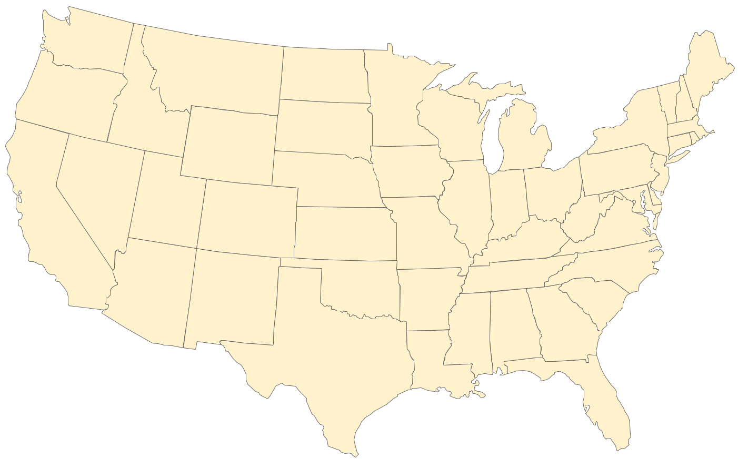
CV Procurement Analysis
Projects/Sites Interviewed (Spring 2018)
Projects/Sites Interviewed
Maricopa County (Anthem) , AZ
State of Colorado (2 interviews)
  Denver, CO (Denver Public Works)
  I-70, statewide
State of Florida (2 interviews)
  Tallahassee, FL
  Osceola County, FL
Atlanta, GA
State of Michigan
Marysville, OH (ATCMTD Grant)
State of Pennsylvania (1 interview)
  Pittsburgh, PA
  Harrisburg, PA
  Philadelphia, PA
State of Utah
Commonwealth of Virginia
Legend:
CV Pilot Site
Interviewed CV Deployment Location
Notes:
This slide shows the different project sites that were included in the 11 interviews that we conducted. (The 3 sites shown in blue in Pennsylvania were handled by one interview, in fact several of the agency contacts provided insight into multiple projects).
This is just for reference if needed:
Maricopa County, AZ (Anthem, AZ) [Faisal Saleem]
State of Colorado
Denver, CO Denver Public Works (ATCMTD Grant) [Matthew McAllister] I-70, statewide (Tyler Svitak (left CDOT, Benjamin Acimovic, and others)
State of Florida
Tallahassee, FL [Raj Ponnaluri]
Osceola County, FL [Jeremy Dilmore]
Atlanta, GA [Alan Davis]
State of Michigan [Collin Castle]
Marysville, OH (ATCMTD Grant) [Eric Phillips and Team]
State of Pennsylvania [Mark Kopko]
Pittsburgh, PA
Harrisburg, PA
Philadelphia, PA
State of Utah [Blaine Leonard]
Commonwealth of Virginia [Virginia Lingham, Cathy McGhee]
Important notes: The 11 interviews represented a good sample of CV projects across various states around the country. We initially targeted about 25 agency contacts (so we had a 44% successful response rate). We also heard back from several individuals that felt they didn’t qualify to provide information to the study, because they had not yet gone through a CV procurement. Most projects are scoped at fewer than 100 total RSUs at this time.
CV pilot sites are shown but since so much is documented about them through the CV pilot program website, they were not the subject of our interviews. We included their findings through the literature review of the project, and have reviewed their comprehensive acquisition and installation plans. Lessons learned from the CV pilot sites are fairly consistent with the findings presented here.

Slide 4
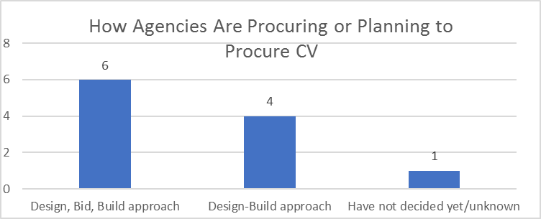
CV Procurement Analysis
Overall Procurement Approach
(Operate-Transfer)
n=11
Notes:
Now, let’s review some of the findings of the study. This chart shows a breakdown of how agencies are approaching CV procurement in terms of work structure and allocation of roles and responsibilities between parties involved in a CV system acquisition.
Most agencies interviewed are using or have used a design, bid, build approach, which is more traditional. With this approach, the public agency retains primary responsibility for specifying and bidding out the hardware and software elements based on the design. This may mean a higher number of contracts/work orders to manage, but gives the DOT direct access to those consultants or suppliers.
On the other hand, several agencies are using a design – build approach, in which the same contractor team designs the system, procures or purchases the equipment, develops needed software and installs the equipment. At the time we talked to them, one of the agencies was still undecided as to how they would proceed with allocating the work for their project.
Optional: skip
[Colorado DOT has a partnership (with Panasonic), being managed similarly to a design – build – operate-transfer (DBOT) job. Colorado DOT's procurement approach is based on a partnership with Panasonic, Ford, and Qualcomm to deploy connected vehicle technology in Colorado. It is essentially a DBOT model, except that Panasonic will continue to operate the CV data ecosystem and provide (lifetime) updates to the CDOT. Panasonic is installing and maintaining the equipment for the duration of the contract, but CDOT still owns it. As CDOT grows CV infrastructure, it plans to own, operate, construct, and maintain it all. The subscription to the data ecosystem is the only thing that will remain for Panasonic to operate and maintain, but CDOT will buildout the hardware network itself. One advantage is that CDOT does not have to maintain and upgrade the software code for the data ecosystem. (Panasonic will do that.)]
There are differences in how the O&M responsibilities are transferred from the contractor team (usually a system integrator) to the responsible IO&O (infrastructure owner and operator) after system acceptance, usually involving some training. However, it does not appear that private firms are being used for long-term system operations and maintenance in a substantial way.

Slide 5
CV Procurement Analysis
Contract Types and Method of Award
Contract Types
  Most agencies are using firm fixed-price contracting (for base tasks)
  T&M (Time & Materials) is next most frequently used
  Optional tasks tend to be done using a T&M approach
Method of Award
  Most agencies appear to be able to use both qualifications and cost factors in selecting contractors
  One agency used a sole-source method of award to bring on a contractor
Notes:
This chart conveys the choice of contract type and method of award used by interviewed agencies.
For type of contract, most agencies we interviewed are using fixed-price contracting (for base tasks). Optional tasks tend to be done using a time & materials approach. We are not sure why firm-fixed price is used so frequently, but it may be that the budget for the project is fixed and FFP becomes a way to manage the deployment costs.
(9 agencies = fixed price, 4 agencies = T&M)
The method of award refers to how the contractor/consultant or vendor was selected; in other words, what factors were considered in the selection. Most CV project contracts included both qualifications and cost factors as a part of the selection. (we were glad to see that). In several cases, equipment demonstrations were also required as part of the selection process.
Most agencies have been able to avoid the low-bid only method of award.

Slide 6


CV Procurement Analysis
Procurement Process Observations
Limitations of the procurement process
  Low-bid source selection requirements or agency policies
  Traditional procurement mechanisms used by DOT’s are not well-suited for CV deployment
  Procurement process takes too much time
About half the interviewees felt that new procurement business processes or practices were required to facilitate CV procurement
Others felt that the existing processes were adequate, but more experience with CV procurement is needed to better utilize them
Key finding: different procurement approaches and processes have been successfully used for purchasing CV equipment, systems, and services
Notes:
Transition: Now I would like to switch gears to our findings based on some procurement-related reflection questions that we asked of the interviewees.
Some overall procurement process observations based on the responses are provided on this slide.
Our respondents identified the following limitations in the procurement process that can affect the success or efficiency of the CV procurement:
low-bid selection requirements,
traditional procurement mechanisms used by DOT's are more suited to buying materials or building a road,
Others lamented that the process takes too long.
Nonetheless, approximately half of the respondents felt that the existing processes were adequate or workable for purchasing CV technology; with more experience in purchasing CV equipment and technologies, the kinks can be ironed out.
An important conclusion of this study is that different procurement approaches have been and will be successfully used for purchasing CV equipment, systems, and services. There's no single best approach or correct way to do it.

Slide 7
CV Procurement Analysis
Overall Observations
Contractor roles vary, but DOTs are giving them a lot of responsibility
  Several DOTs have design-build (-transfer) or (–operate-transfer) contracts with contractors
  Several DOTs are using traditional design – bid – build approach
  Some DOTs have used both of these approaches for CV projects
  Agencies are using contractor/consultants to perform or assist with project planning, project specifications, and oversight (systems manager roles) as well as for systems integration role
Several agencies partnered with universities
Many agencies still do not have direct experience with CV procurements
Notes:
Now, let me discuss some overall observations based on what we learned.
Overall observations
Contractor roles varied, but DOT’s are giving them a lot of responsibility
Several DOT’s have design-build (-transfer) or (–operate-transfer) contracts with contractors, especially for larger projects
Potentially easier to manage for the DOT
Higher-risk for contractor, especially given the systems integration task
Several DOT’s are still using the more traditional design – bid – build approach
May involve several contracts for the DOT to manage, but offers more control of specifications as technology and standards evolve
Some DOT’s have used both approaches. (FL, MI)
Some DOT’s partnering with universities (e.g., VA, PA, AZ)
Especially for early stage deployments and testing purposes
Universities often purchased the DSRC equipment for testing and research purposes
Although the trend here is to move away from research to a deployment environment focused on addressing real transportation needs and solving problems.
Many DOT’s still do not have any direct experience with CV procurements.
This is an important finding. We expect there will be continued demand for information and technical assistance related to CV procurement and deployment in the future.

Slide 8

CV Procurement Analysis
Observed Trends
Research
and
Testing
Mainstream
Deployment
Smaller Projects
Larger
Projects
Scope Expanding from SPaT/MAP only to Multiple Applications
Increasing Use of Design-Build-Operate-Transfer Approach
Increasing Use of Agile Development Methods
Notes:
This slide shows the trends we observed in CV projects... Where things are headed....
The 1st trend: From: Research and Testing to Mainstream Deployment (We noticed that agencies are moving from simply testing the technology toward deployment of CV systems that are solving real transportation problems and addressing their transportation needs)
The 2nd trend: From: Smaller Projects to Larger Projects (e.g. more infrastructure equipment like RSUs). This goes hand-in-hand with the first trend.
The 3rd trend: Scope Expanding from SPaT/MAP projects to Multiple Applications, Moving from meeting the SPaT challenge to broader
projects with more applications built in intended to affect transportation outcomes.
The 4th trend: Increasing Use of Design-Build-Operate-Transfer Approach -- this approach streamlines contracting from the perspective of the agency
The 5th trend: Increasing Use of Agile Development Methods -- Especially for newer, larger projects with lots of software

Slide 9
CV Procurement Analysis
Procurement Challenges Faced
Growing pains of a young market
  Robust, mature marketplace still isn’t there today
    Very low market penetration for infrastructure and vehicle equipment
  Vendors are still fine tuning equipment and software and working interoperability issues associated with deployment
  Standards and technology are still evolving
  Not yet ready for high volume production of devices
Communication problems with procurement staff
Understanding and executing FCC licensing process
Funding may not be readily available for large-scale CV projects
Lack of federal mandate and uncertain outlook for DSRC contributing to deployment delays
Notes:
What were the key challenges that had to be accounted for or addressed by each project’s CV procurement activity?
The main procurement challenge is that the market is still very young when compared to other transportation markets. We have very low market penetration for intersections, roadside, and vehicle equipment today. We are in the early adopter stage of the technology market adoption curve.
(Read/paraphrase the following points from the slide)
Vendors are still fine tuning equipment and software and working interoperability issues associated with deployment
Standards and technology are still evolving
Vendor interoperability claims may not translate to your environment
RSU vendors not always compatible with varying signal controller equipment across the state
Not yet ready for high volume production of devices
Note that we are making great strides in this area due to the CV Pilot program and the related interoperability testing.
Another challenge noted was that communication problems emerged between the project manager and the purchasing department, because their staff is not used to this type of technology (for instance, they did not understand or appreciate the lack of market maturity).
With regard to the last bullet point, CV deployers would like to know the US DOT's position or stance on 5.9 GHz DSRC, in the absence of a mandate for now. Some agencies were hesitant to commit a lot of funding to CV deployment in the absence of more clarity here. This also affects vendors willingness to invest in product improvements and research and development.

Slide 10

CV Procurement Analysis
Sample of Recommendations and Best Practices
Explore your contracting options for purchasing CV equipment such as communication devices, RSUs, and OBUs
Find a way to test potential offerors equipment with your signal equipment, controllers, and related infrastructure as part of your overall procurement strategy and vendor selection process
For big CV purchases with large quantities, consider contracting with multiple vendors to maximize flexibility and manage the risk of not meeting delivery targets
Use the right expertise
  CV subject matter experts
  Contracting and legal expertise
  Expertise in FCC licensing process for DSRC
Notes:
Next 2 slides provide a sample of the recommendations and best practices we obtained from the interviewees and CV Pilot sites. The recommendations come from those who have deployed connected vehicle technologies in the field.

Slide 11
CV Procurement Analysis
Sample of Recommendations and Best Practices (2)
Plan for hardware and software issues to occur
  Require ongoing vendor support during testing and initial operations
  Consider use of service-level agreements
Be conservative in your OBU installation schedule projections
Consider ways to approach CV project development and procurement that are more flexible than the approach of fully specifying and documenting all requirements upfront
  Consider phased or agile approaches
  Consider service provider model approach for CV deployments
Notes:
Continuing the sample recommendations and best practices as reported by the interviewees (and CV Pilot Sites).
Be conservative in your OBU installation schedule projections - If you're equipping private vehicles, the public citizens may not keep their appointment times, which adds to the delay.
Also, different models and makes of vehicles (or trucks) present challenges for installation

Slide 12
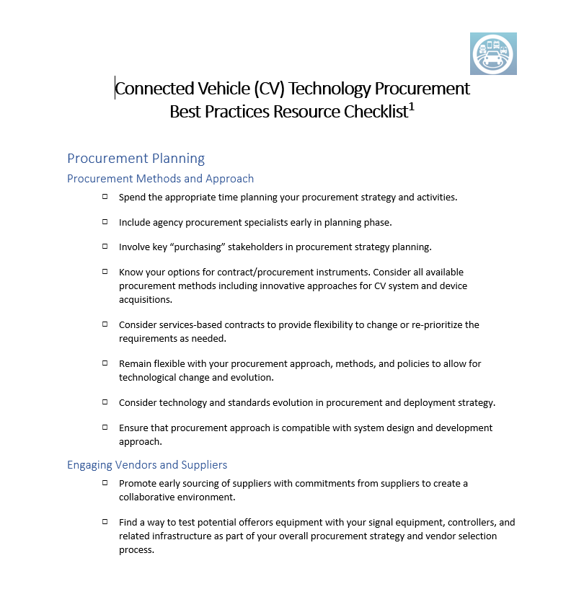
CV Procurement Analysis
Additional Product of Study
  Best Practices Resource Checklist (available upon request)
    5-page checklist of best practice considerations
    Grouped into topic areas
      Procurement Methods and Approach
      Engaging Vendors and Suppliers
      Procurement Specification or Contracting Language
      System Design and Development
      Communications
      Resources
      Training Needs
      Schedule Considerations
Notes:
Based on but not contained in the report…..on the right is a snapshot of the first page…

Slide 13
CV Procurement Analysis
Want More Information?
Connected Vehicle Procurement State of the Practice Assessment: Summary Findings Report (Final), FHWA-JPO-18-703
Points of Contact
Elina Zlotchenko (ITS Joint Program Office)
Elina.Zlotchenko@dot.gov
  John Corbin (FHWA Office of Operations)
    John.Corbin@dot.gov
  Greg Hatcher (Noblis On-site JPO Support Team)
    Greg.Hatcher.ctr@dot.gov
Notes:
If you would like additional information or have any questions, here are the points of contact and the reference/link to the final report.

